Slide 1
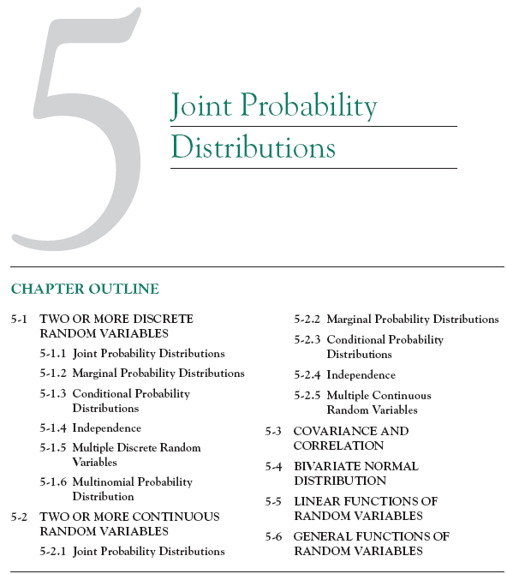

Slide 2
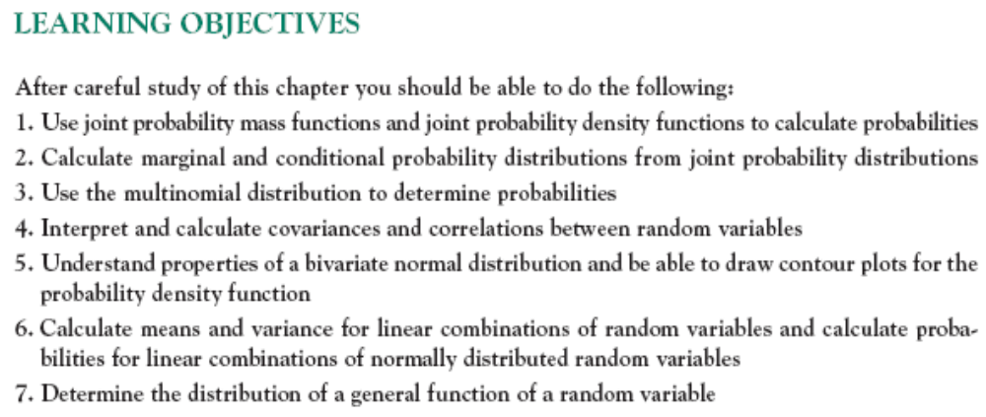

Slide 3
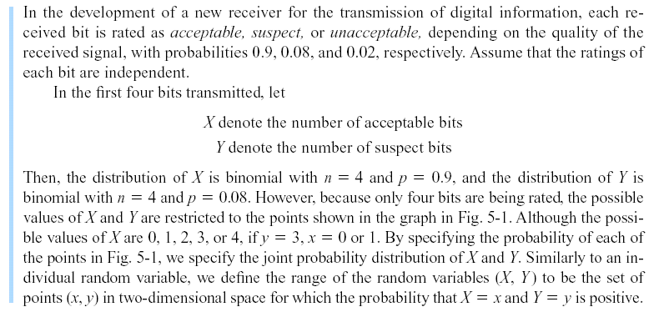
5-1 Two Discrete Random Variables
Example 5-1

Slide 4
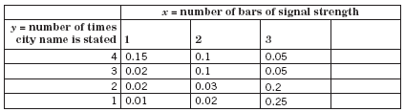
5-1 Two Discrete Random Variables
Figure 5-1 Joint probability distribution of X and Y in Example 5-1.

Slide 5
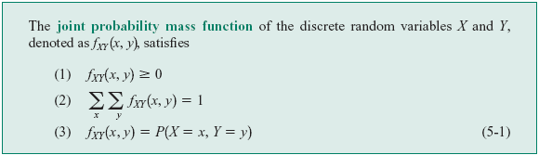
5-1 Two Discrete Random Variables
5-1.1 Joint Probability Distributions

Slide 6
5-1 Two Discrete Random Variables
5-1.2 Marginal Probability Distributions
The individual probability distribution of a random variable is referred to as its marginal probability distribution.
In general, the marginal probability distribution of X can be determined from the joint probability distribution of X and other random variables. For example, to determine P(X = x), we sum P(X = x, Y = y) over all points in the range of (X, Y ) for which X = x. Subscripts on the probability mass functions distinguish between the random variables.

Slide 7
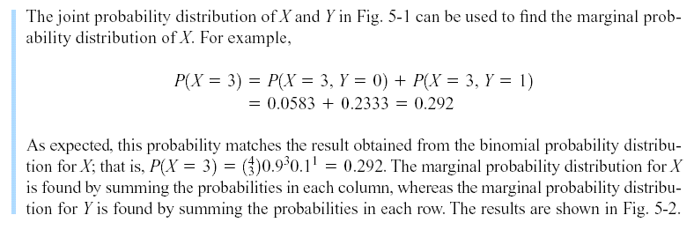
5-1 Two Discrete Random Variables
Example 5-2

Slide 8
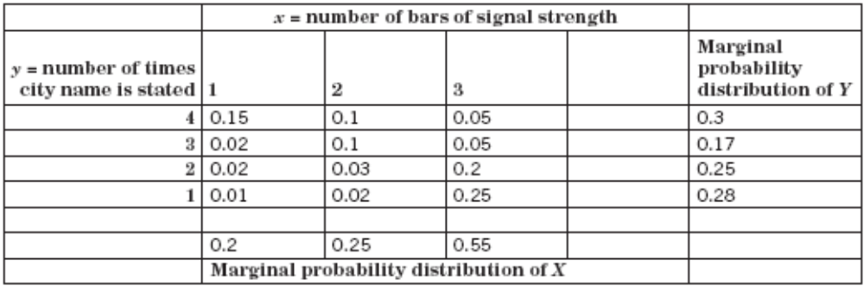
5-1 Two Discrete Random Variables
Figure 5-2 Marginal probability distributions of X and Y from Figure 5-1.

Slide 9
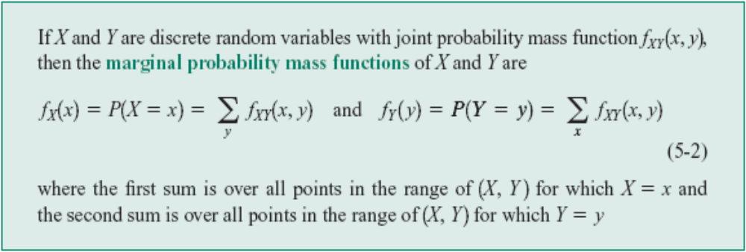
5-1 Two Discrete Random Variables
Definition: Marginal Probability Mass Functions

Slide 10
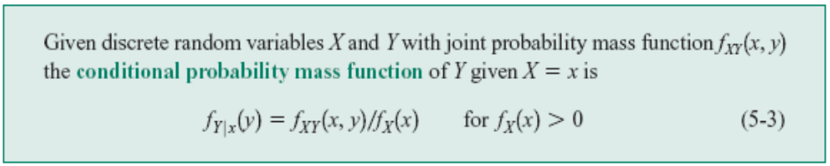
5-1 Two Discrete Random Variables
5-1.3 Conditional Probability Distributions

Slide 11
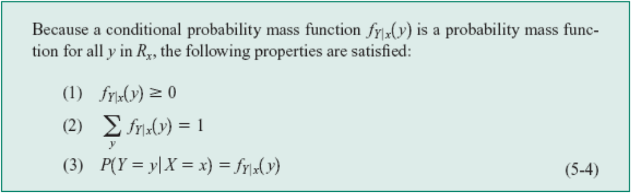
5-1 Two Discrete Random Variables
5-1.3 Conditional Probability Distributions

Slide 12
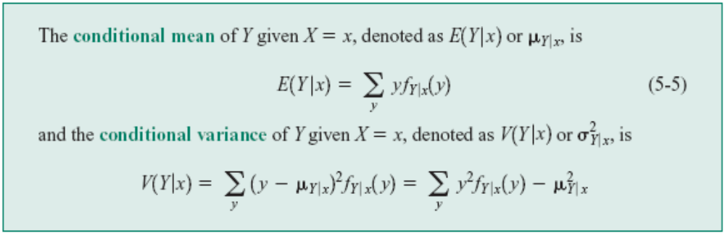
5-1 Two Discrete Random Variables
Definition: Conditional Mean and Variance

Slide 13
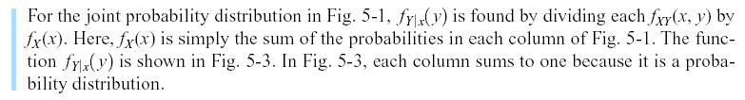
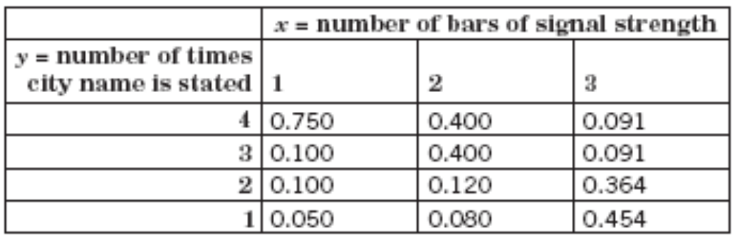
Example 5-4
Figure 5-3 Conditional probability distributions of Y given X, f_{Y|x}(y) in Example 5-6.

Slide 14
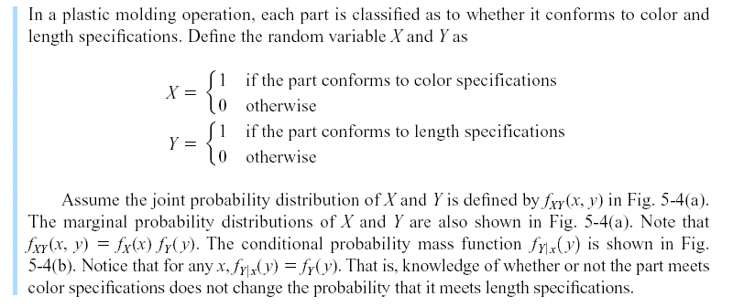
5-1 Two Discrete Random Variables
5-1.4 Independence
Example 5-6

Slide 15
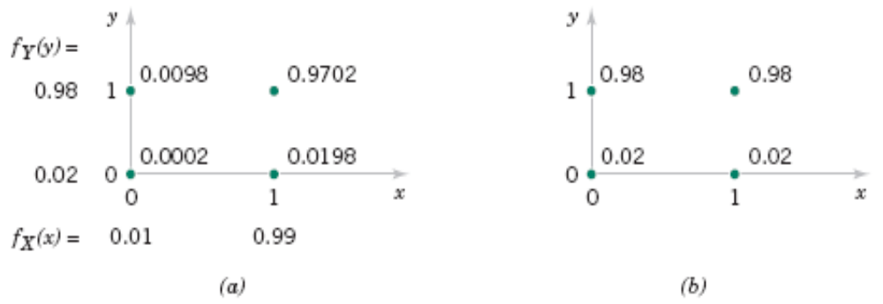
Example 5-8
Figure 5-4 (a)Joint and marginal probability distributions of X and Y in Example 5-8. (b) Conditional probability distribution of Y given X = x in Example 5-8.

Slide 16
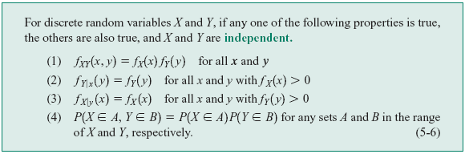
5-1 Two Discrete Random Variables
5-1.4 Independence

Slide 17
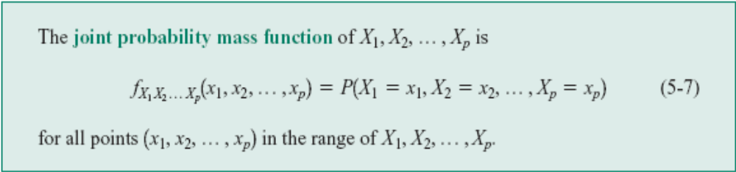
5-1 Two Discrete Random Variables
5-1.5 Multiple Discrete Random Variables
Definition: Joint Probability Mass Function

Slide 18
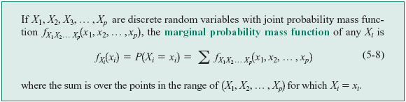
5-1 Two Discrete Random Variables
5-1.5 Multiple Discrete Random Variables
Definition: Marginal Probability Mass Function

Slide 19
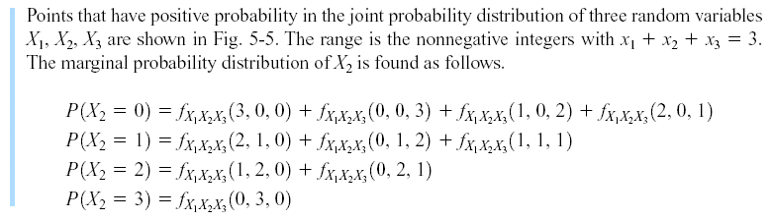
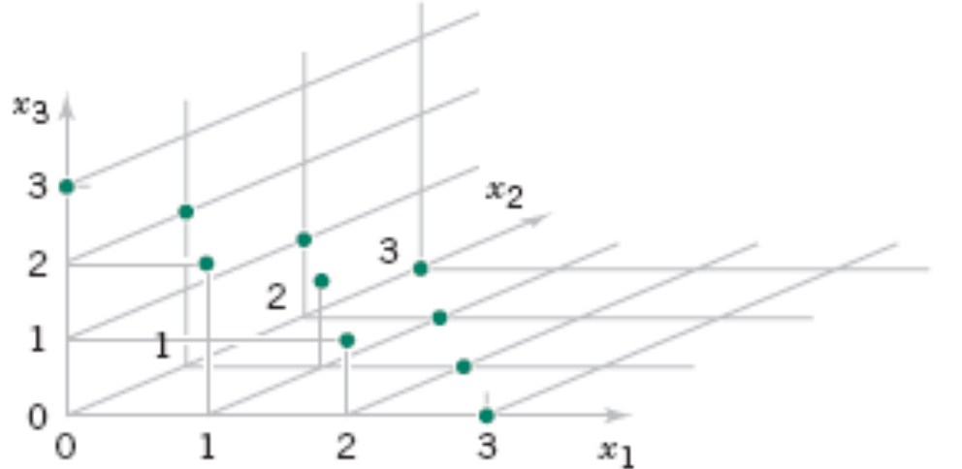
5-1 Two Discrete Random Variables
Example 5-8
Figure 5-5 Joint probability distribution of X₁, X₂, and X₃.

Slide 20
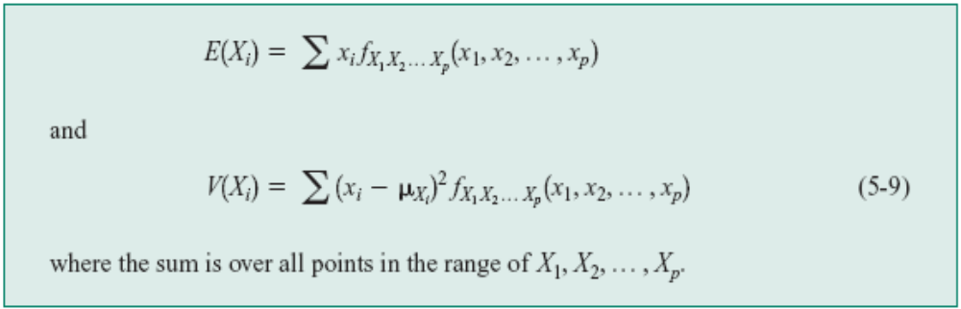
5-1 Two Discrete Random Variables
5-1.5 Multiple Discrete Random Variables
Mean and Variance from Joint Probability

Slide 21
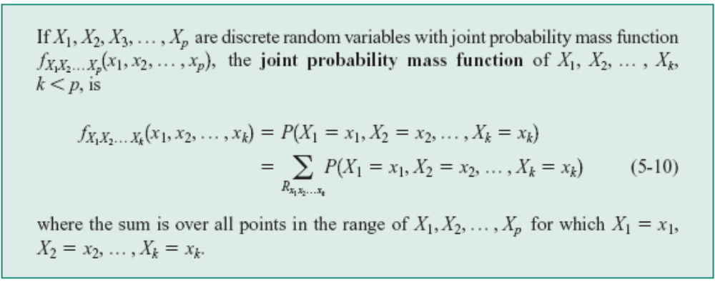
5-1 Two Discrete Random Variables
5-1.5 Multiple Discrete Random Variables
Distribution of a Subset of Random Variables

Slide 22
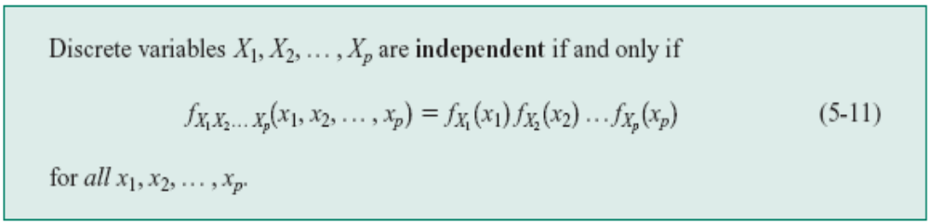
5-1 Two Discrete Random Variables
5-1.5 Multiple Discrete Random Variables
Conditional Probability Distributions

Slide 23
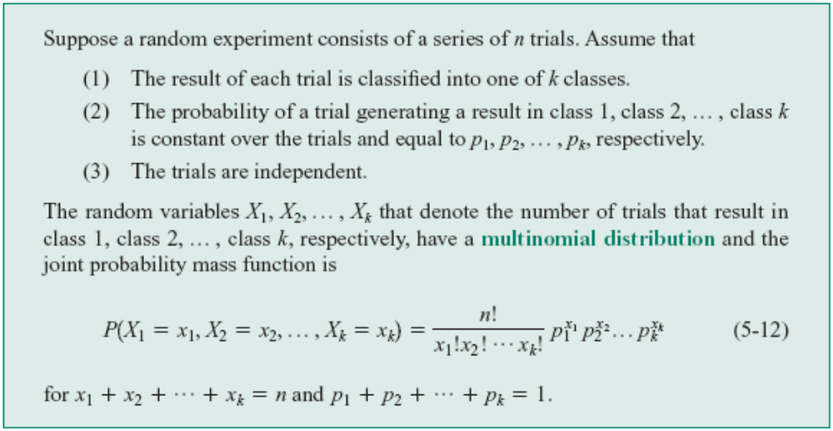
5-1 Two Discrete Random Variables
5-1.6 Multinomial Probability Distribution

Slide 24
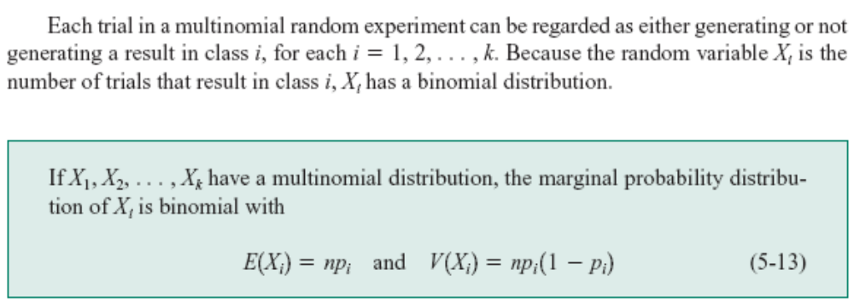
5-1 Two Discrete Random Variables
5-1.6 Multinomial Probability Distribution

Slide 25
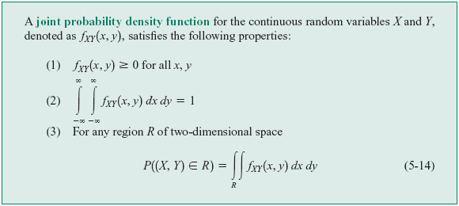
5-2 Two Continuous Random Variables
5-2.1 Joint Probability Distribution
Definition

Slide 26
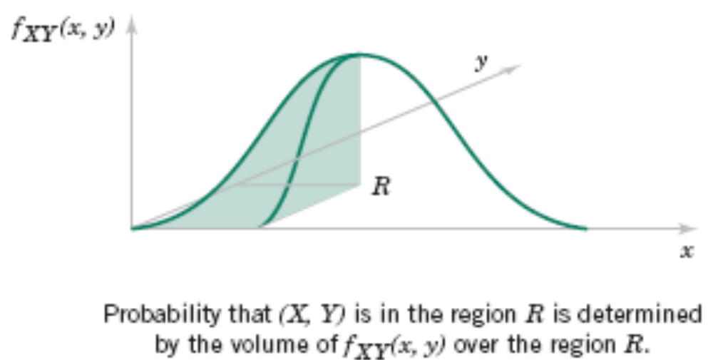
5-2 Two Continuous Random Variables
Figure 5-6 Joint probability density function for random variables X and Y.

Slide 27
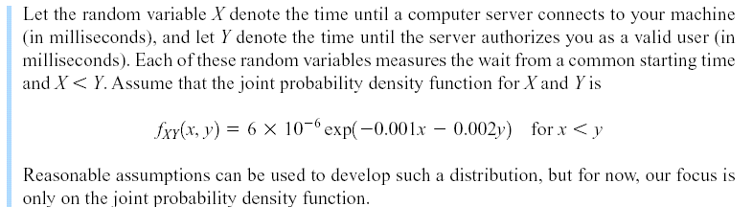
5-2 Two Continuous Random Variables
Example 5-12

Slide 28
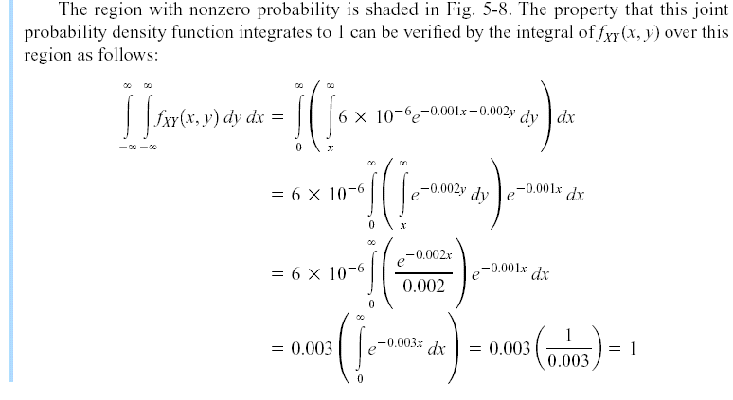
5-2 Two Continuous Random Variables
Example 5-12

Slide 29
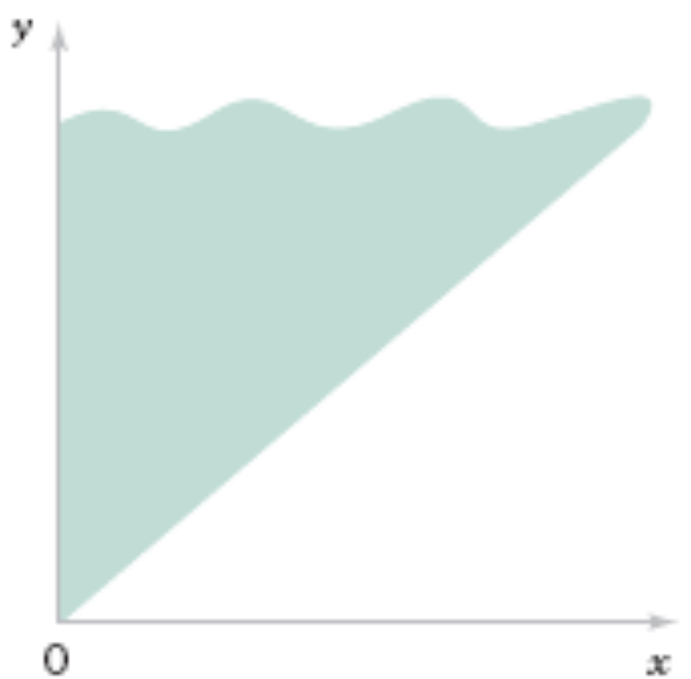
5-2 Two Continuous Random Variables
Figure 5-8 The joint probability density function of X and Y is nonzero over the shaded region.

Slide 30
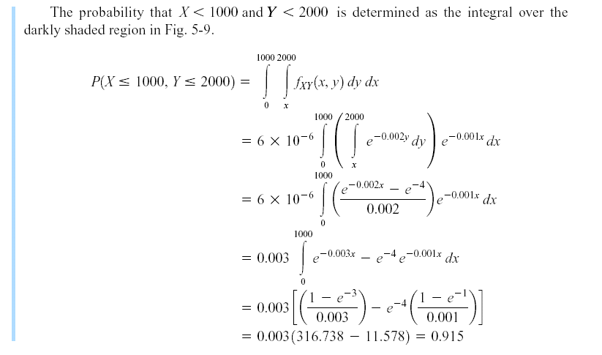
5-2 Two Continuous Random Variables
Example 5-12

Slide 31
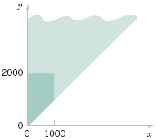
5-2 Two Continuous Random Variables
Figure 5-9 Region of integration for the probability that X < 1000 and Y < 2000 is darkly shaded.

Slide 32
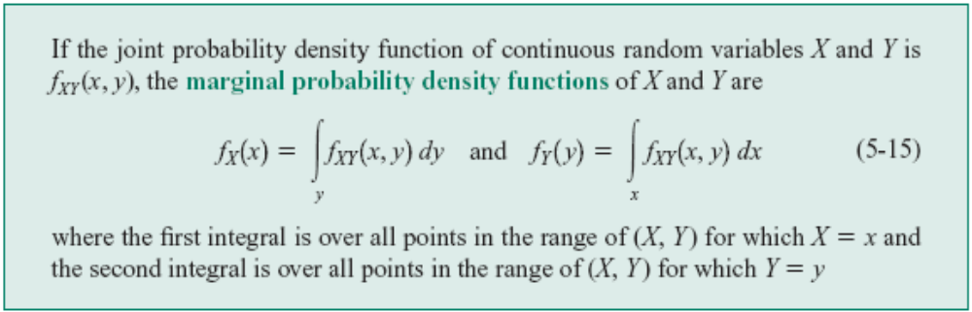
5-2 Two Continuous Random Variables
5-2.2 Marginal Probability Distributions
Definition

Slide 33
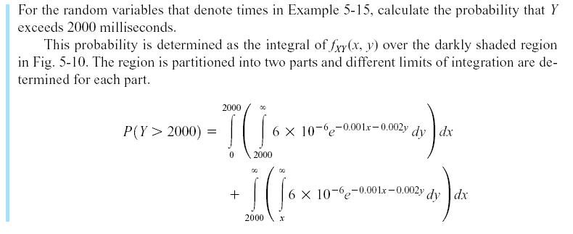
5-2 Two Continuous Random Variables
Example 5-13

Slide 34
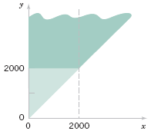
5-2 Two Continuous Random Variables
Figure 5-10 Region of integration for the probability that Y < 2000 is darkly shaded and it is partitioned into two regions with x < 2000 and and x > 2000.

Slide 35
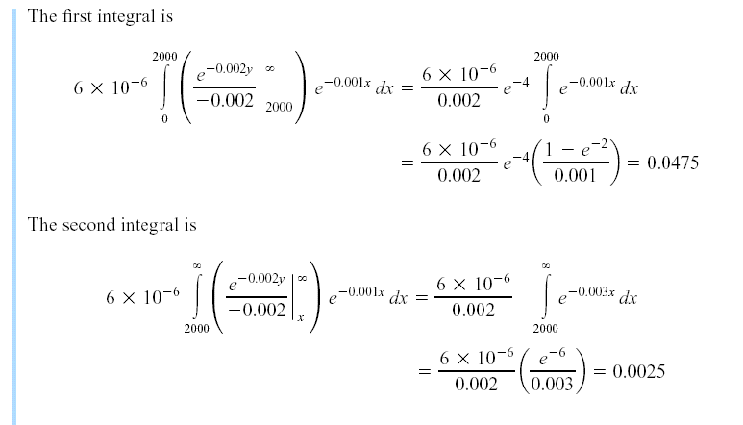
5-2 Two Continuous Random Variables
Example 5-13

Slide 36
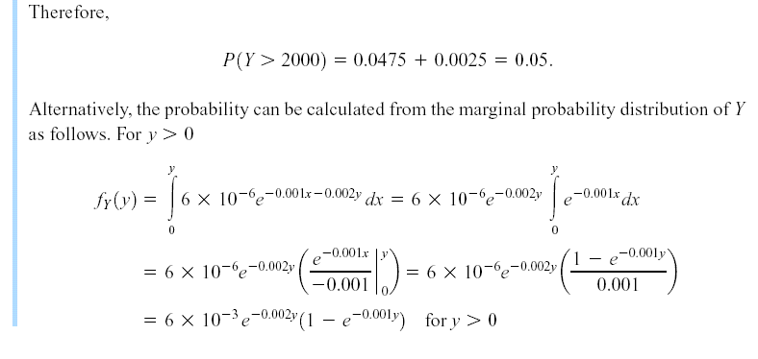
5-2 Two Continuous Random Variables
Example 5-13

Slide 37
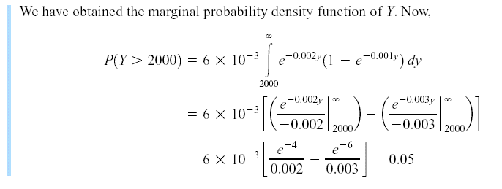
5-2 Two Continuous Random Variables
Example 5-13

Slide 38
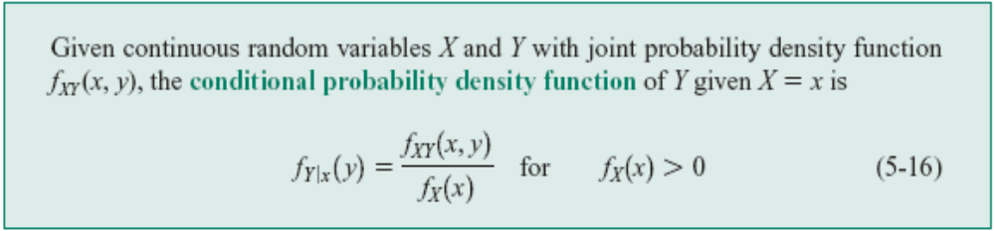
5-2 Two Continuous Random Variables
5-2.3 Conditional Probability Distributions
Definition

Slide 39
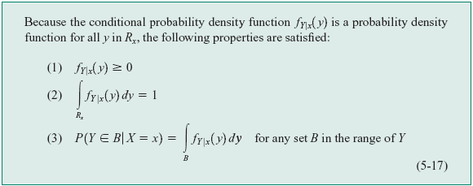
5-2 Two Continuous Random Variables
5-2.3 Conditional Probability Distributions

Slide 40
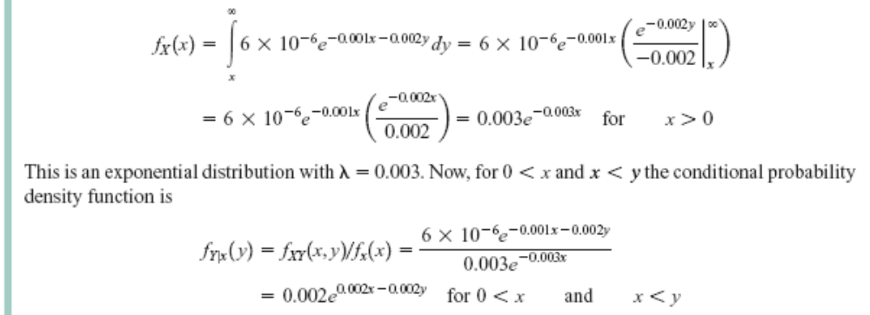
5-2 Two Continuous Random Variables
Example 5-14

Slide 41
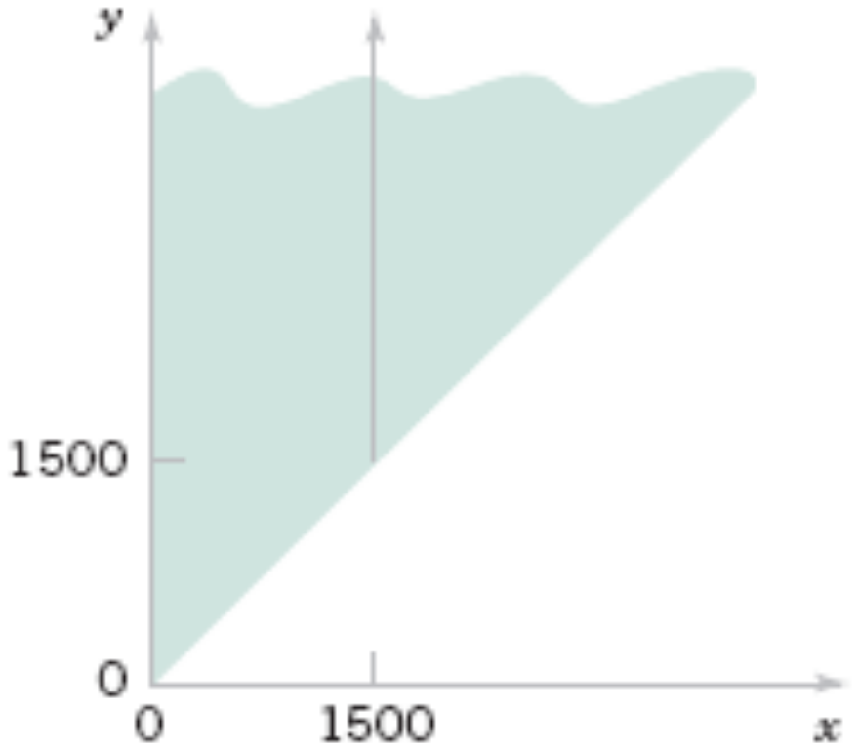
5-2 Two Continuous Random Variables
Example 5-14
Figure 5-11 The conditional probability density function for Y, given that x = 1500, is nonzero over the solid line.

Slide 42
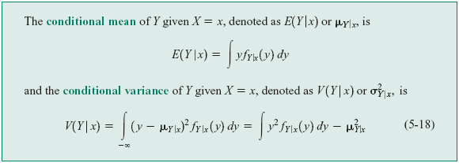
5-2 Two Continuous Random Variables
Definition: Conditional Mean and Variance

Slide 43
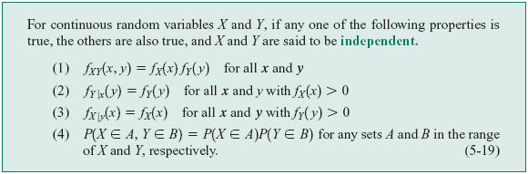
5-2 Two Continuous Random Variables
5-2.4 Independence
Definition

Slide 44
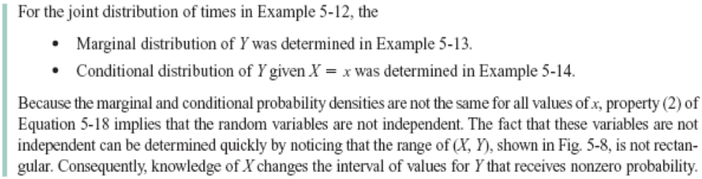
5-2 Two Continuous Random Variables
Example 5-16

Slide 45
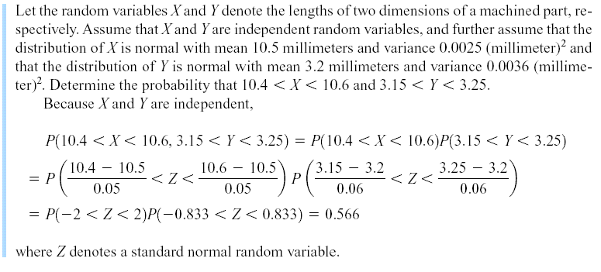
5-2 Two Continuous Random Variables
Example 5-18

Slide 46
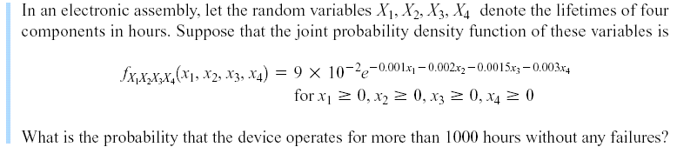
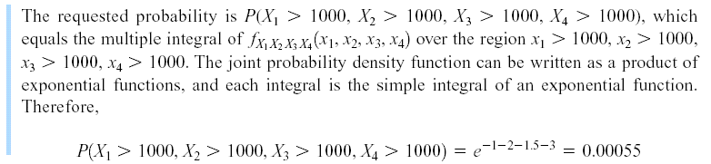
5-2 Two Continuous Random Variables
Example 5-20

Slide 47
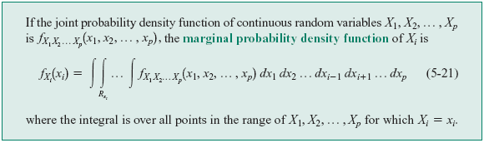
5-2 Two Continuous Random Variables
Definition: Marginal Probability Density Function

Slide 48
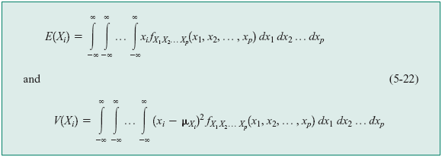
5-2 Two Continuous Random Variables
Mean and Variance from Joint Distribution

Slide 49

5-2 Two Continuous Random Variables
Distribution of a Subset of Random Variables

Slide 50

5-2 Two Continuous Random Variables
Conditional Probability Distribution
Definition

Slide 51


5-2 Two Continuous Random Variables
Example 5-23

Slide 52

5-2 Two Continuous Random Variables
Example 5-23

Slide 53

5-3 Covariance and Correlation
Definition: Expected Value of a Function of Two Random Variables

Slide 54

5-3 Covariance and Correlation
Example 5-24

Slide 55

5-3 Covariance and Correlation
Example 5-24
Figure 5-12 Joint distribution of X and Y for Example 5-24.

Slide 56


5-3 Covariance and Correlation
Definition

Slide 57

5-3 Covariance and Correlation
Figure 5-13 Joint probability distributions and the sign of covariance between X and Y.

Slide 58


5-3 Covariance and Correlation
Definition

Slide 59

5-3 Covariance and Correlation
Example 5-26
Figure 5-14 Joint distribution for Example 5-26.

Slide 60

5-3 Covariance and Correlation
Example 5-26 (continued)

Slide 61


5-3 Covariance and Correlation
Example 5-28
Figure 5-16 Random variables with zero covariance from Example 5-28.

Slide 62

5-3 Covariance and Correlation
Example 5-28 (continued)

Slide 63

5-3 Covariance and Correlation
Example 5-28 (continued)

Slide 64

5-3 Covariance and Correlation
Example 5-28 (continued)

Slide 65

5-4 Bivariate Normal Distribution
Definition

Slide 66

5-4 Bivariate Normal Distribution
Figure 5-17. Examples of bivariate normal distributions.

Slide 67


5-4 Bivariate Normal Distribution
Example 5-30
Figure 5-18

Slide 68

5-4 Bivariate Normal Distribution
Marginal Distributions of Bivariate Normal Random Variables

Slide 69


5-4 Bivariate Normal Distribution
Figure 5-19 Marginal probability density functions of a bivariate normal distributions.

Slide 70


5-4 Bivariate Normal Distribution

Slide 71

5-4 Bivariate Normal Distribution
Example 5-31

Slide 72


5-5 Linear Combinations of Random Variables
Definition
Mean of a Linear Combination

Slide 73

5-5 Linear Combinations of Random Variables
Variance of a Linear Combination

Slide 74

5-5 Linear Combinations of Random Variables
Example 5-33

Slide 75

5-5 Linear Combinations of Random Variables
Mean and Variance of an Average

Slide 76

5-5 Linear Combinations of Random Variables
Reproductive Property of the Normal Distribution

Slide 77


5-5 Linear Combinations of Random Variables
Example 5-34

Slide 78

5-6 General Functions of Random Variables
A Discrete Random Variable

Slide 79

5-6 General Functions of Random Variables
Example 5-36

Slide 80

5-6 General Functions of Random Variables
A Continuous Random Variable

Slide 81

5-6 General Functions of Random Variables
Example 5-37

Slide 82


